Slide 1
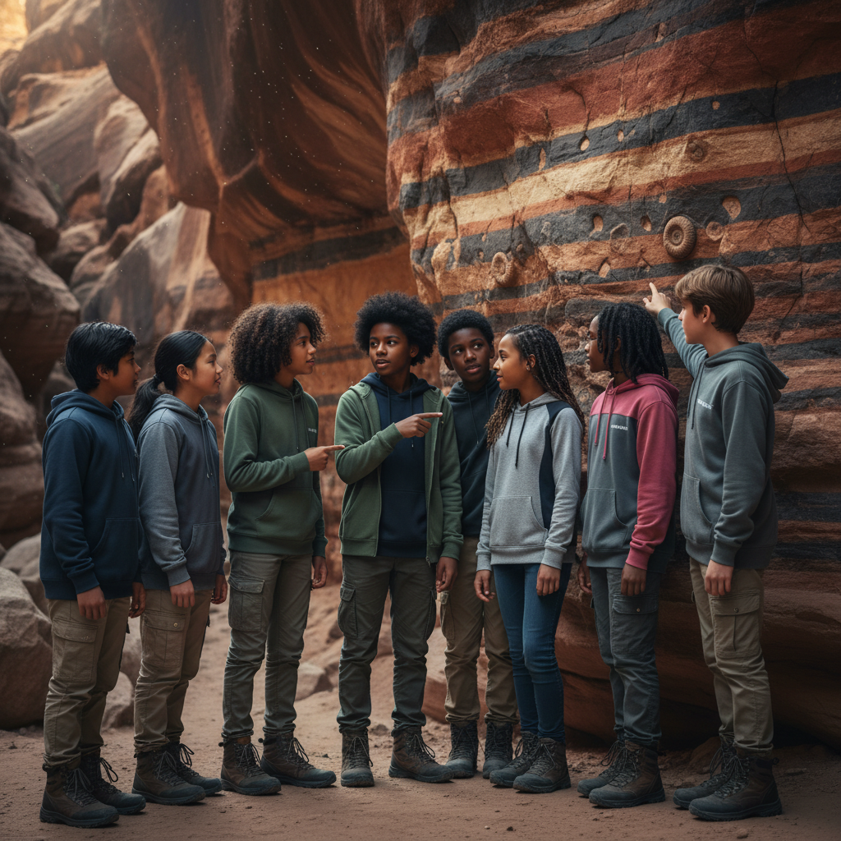
ModelIt!
Student Lesson
The Crime Scene in Every Rock
Reading Earth's History One Layer at a Time
NGSS: MS-ESS1-4
7th Grade
1/9

Slide 2
What You Will Learn Today
Learning Goals
* Explain how rock strata form layers that represent different time periods
* Model the relationship between sedimentation, erosion, and fossil preservation
* Use the principle of superposition to determine relative age of rock layers
* Reconstruct past environments using evidence found in rock layers
Key Vocabulary
Stratigraphy
The study of rock layers (strata) and their arrangement to understand Earth's history
Sedimentary Rock
Rock formed from compressed layers of sediment — sand, mud, shells — that accumulate over time
Superposition
The principle that in undisturbed rock layers, the oldest layers are on the bottom and youngest on top
Index Fossil
A fossil from an organism that lived for a short time but across a wide area, used to date rock layers
2/9

Slide 3
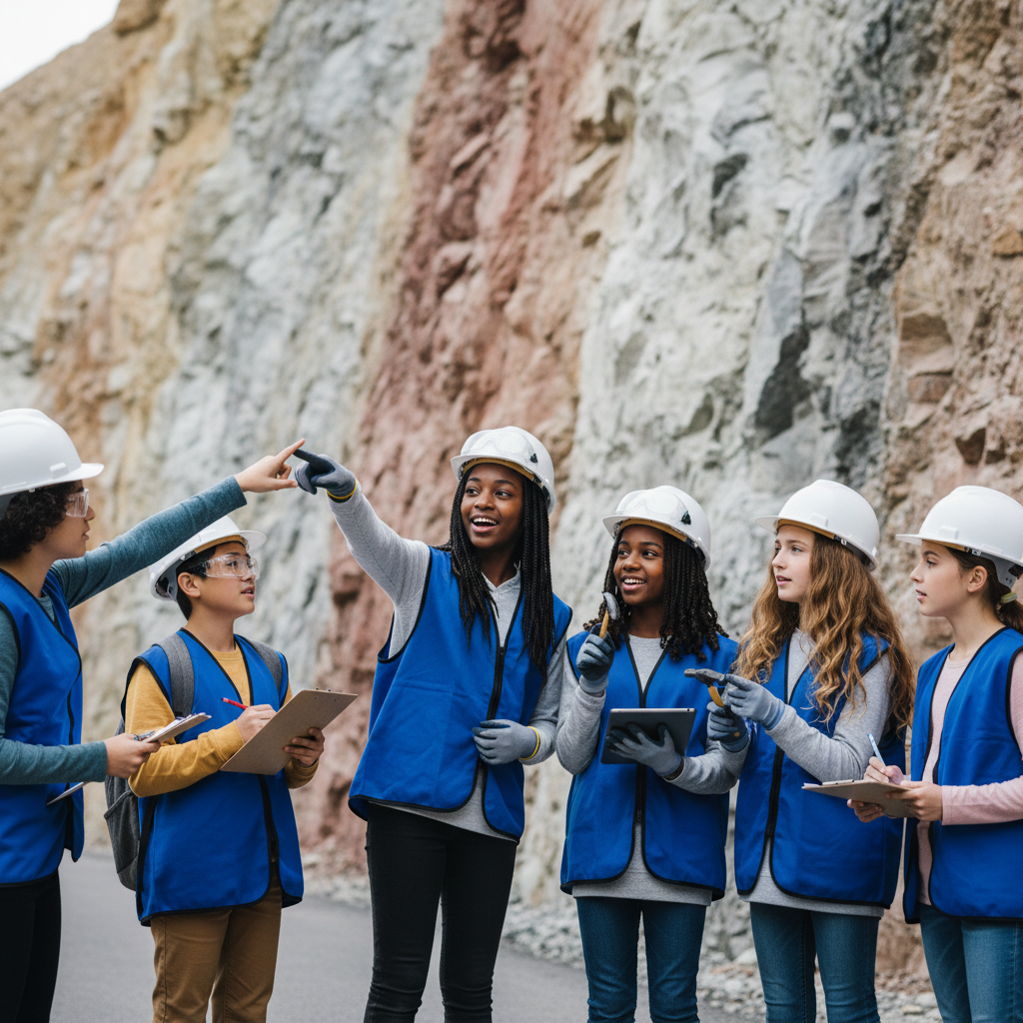
The Big Question
How can a single rock tell you what happened on Earth millions of years ago?
Reading Earth's History One Layer at a Time. Today we'll build a MODEL to discover the answer!
3/9

Slide 4
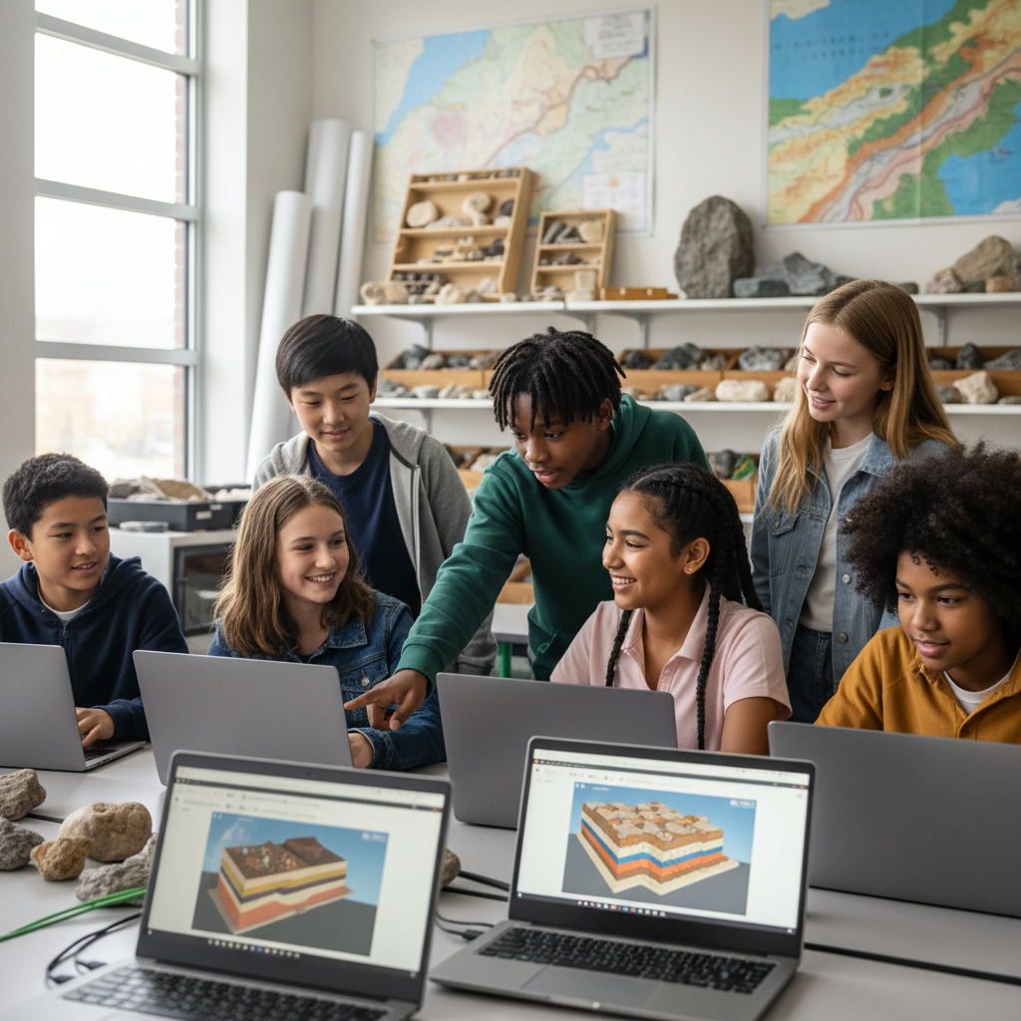
Today We Will Build a Model!
A model helps us understand complex systems!
1. LOCATE
Identify the COMPONENTS (parts) of the system
2. ESTABLISH
Connect them with RELATIONSHIPS (+ or -)
3. VISUALIZE
Build your model in ModelIt!
4. EVALUATE
Run SIMULATIONS to test scenarios
5. REVISE
Improve your model based on evidence
4/9

Slide 5
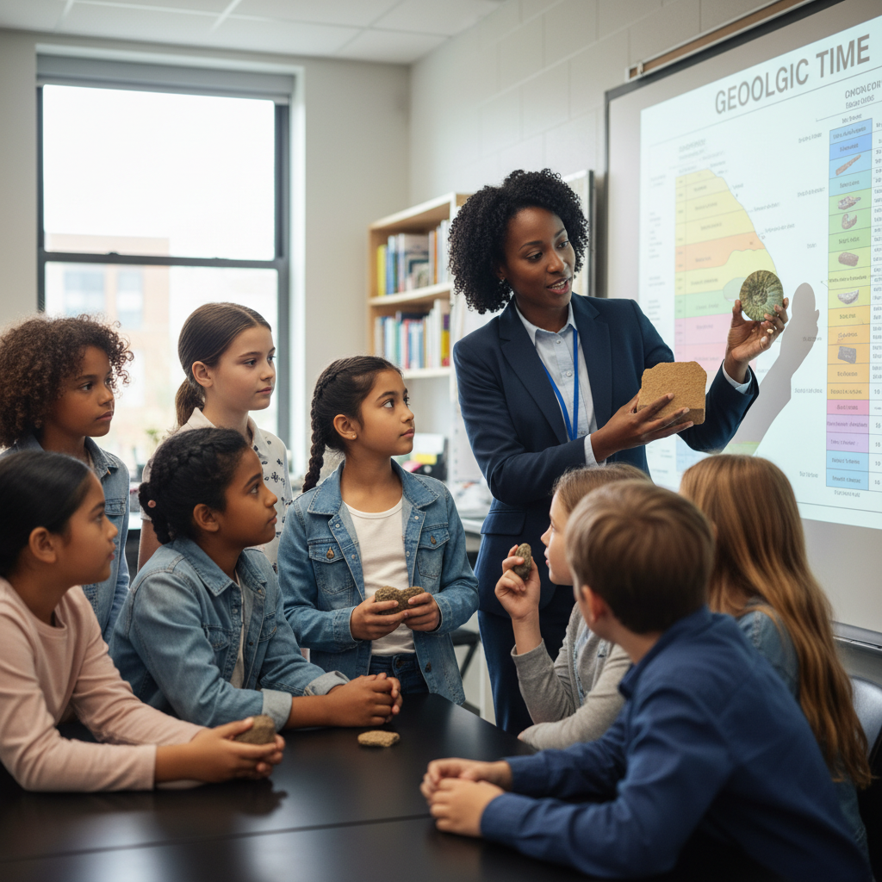
Activity 1: Sort the Components
Sort these components into EXTERNAL (inputs from outside) and INTERNAL (inside the system):
Your Components:
* Sedimentation Rate
* Erosion Rate
* Rock Layer Thickness
* Fossil Preservation Quality
Think: Which components can we control? Which happen on their own?
5/9

Slide 6
Activity 2: Connect with Arrows
Draw arrows to show HOW components affect each other:
(+) POSITIVE Relationship
When one goes UP, the other goes UP too
(-) NEGATIVE Relationship
When one goes UP, the other goes DOWN
Think About It:
When sedimentation rate is very high (like during a flood or volcanic eruption), what happens to fossil preservation quality compared to normal, slow deposition?
6/9

Slide 7
Activity 3: Run the Simulation!
Test these scenarios in ModelIt!
Rapid Deposition
Lock Sedimentation Rate to maximum (flood or volcanic ash) and observe layer thickness and preservation
Heavy Erosion
Set Erosion Rate to maximum and observe what happens to the rock record
Normal Conditions
Set moderate rates for both and observe balanced geological processes
Watch the activity graphs change!
[ModelIt Platform Screenshot - Simulation Results Graph]
7/9

Slide 8
What Did We Discover?
Our Model Showed Us:
* Rock layers are like pages in a book — each one records conditions at the time it formed
* Rapid burial preserves fossils best because organisms are protected from decomposition and scavengers
* Erosion creates gaps in the rock record — millions of years of history can be missing from a single location
* The principle of superposition allows us to determine which layers (and fossils) are older or younger
Answer: Rocks are history books written in stone. Each layer records the environment when it formed — ocean sediments contain marine fossils, desert layers contain sand dunes, volcanic layers contain ash. By reading layers from bottom to top (superposition), we can reconstruct millions of years of Earth's story!
8/9

Slide 9
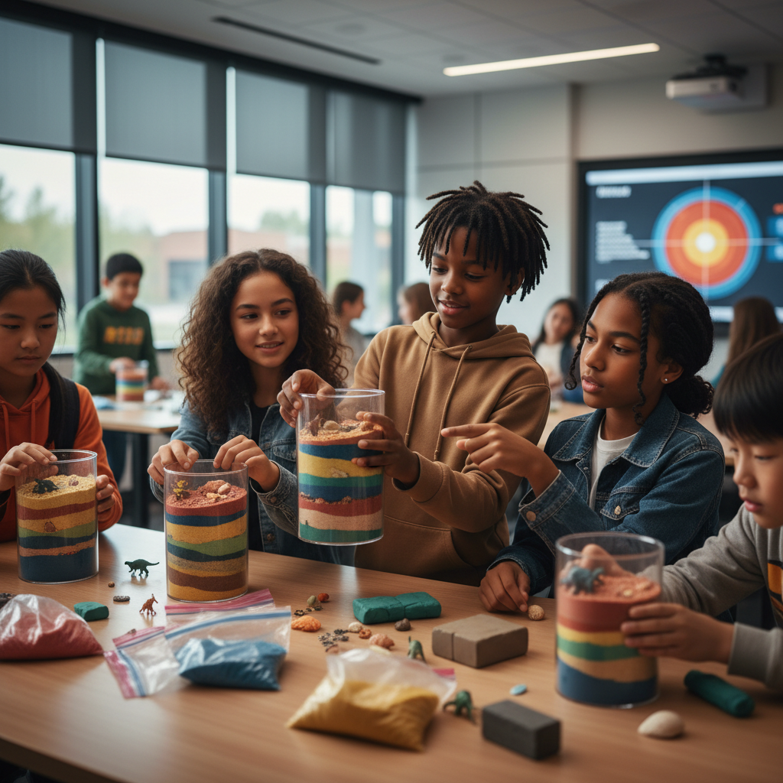
STEM Challenge: Create a Rock Core Sample Model
YOUR ENGINEERING MISSION
Build a physical model of a rock core sample showing at least 5 distinct geological periods, each with appropriate fossils and environmental evidence.
The Challenge:
A museum of natural history needs an educational core sample exhibit showing how geologists read Earth's history from rock layers. Your team will build the model and write the interpretive guide.
Think Like an Engineer:
* What evidence in each layer tells you about the environment at that time?
* How do you show the principle of superposition in your core sample?
* What would a gap (unconformity) in your layers represent?
REAL CAREER CONNECTION: Geologists and Stratigraphers study rock formations to understand Earth's history, locate natural resources, and assess geological hazards. They earn $65,000–$115,000/year. The skills you're using TODAY are the same ones they use on the job!
9/9

